Slide 1
Research Methodology CS 5001 Instructor: Dr. Ramoza Ahsan

Slide 2
Agenda
Review of Quiz Solution
Review of Assignment 1
How to write Literature Review
Sample Literature reviews
Citations
Questions

Slide 3
Contact Details
Contact
Dr. Ramoza Ahsan,
Assistant Professor, Artificial Intelligence and Data Science, School of Computing
Email: ramoza.ahsan@nu.edu.pk
Office: 202a in C block
Ramadan Office Hours : Monday 10m-12pm and Wednesday 10am – 3pm (In-person)
Friday 1-2pm.
Teaching Assistant: Muhammad Bilal <i247611@isb.nu.edu.pk>
Class code: sy4xfcc

Slide 4
Background
During topic selection assignment,
You performed various searches,
And shortlisted the papers related to your topic.

Slide 5
What is a review article?
A review article is a type of secondary literature that talks about previously published work.
“Review articles give an overview of existing literature in a field, often identifying specific problems or issues and analyze information from available published work on the topic with a balanced perspective”.
6 Article types that journals publish: A guide for early career researchers – Kakolo Majumer

Slide 6
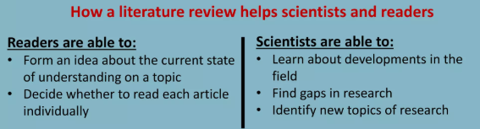
What is literature review?
A literature review is a critical summary of the published works on a particular topic.
It analyzes specific issues
It identifies trends in research
It points out research gaps in existing literature

Slide 7
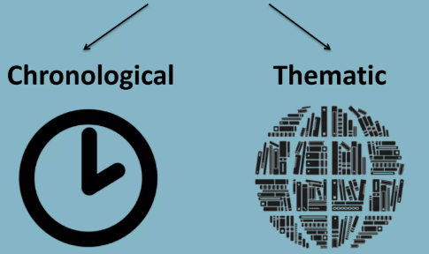
What is literature review?
You can write literature review using one of the following approaches

Slide 8
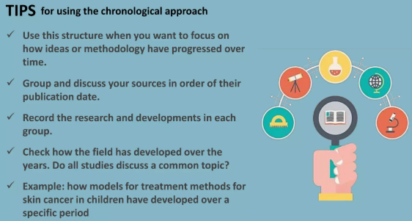
The chronological approach
Describe each work in succession, starting with the earliest available information

Slide 9
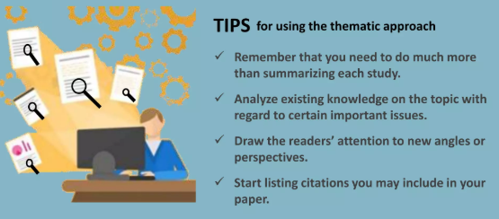
The thematic approach
Organize and discuss existing literature based on themes or theoretical concepts you feel are important to understand the topic

Slide 10
Writing the Literature Review (LR) Section
What to write
Write few liner summary of each paper.
Background on what they have done: 2 Lines
How they solve the problem: 3-4 Lines
Strength and Weaknesses of their proposed work: 3-4 lines
Once written, divide your shortlisted papers into various categories based on their aim/goal or approach to solve the problem
Paste the written material into respective categories
Create a table to categorize the papers.
Sample paper: Liu, Yike, Tara Safavi, Abhilash Dighe, and Danai Koutra. "Graph summarization methods and applications: A survey." ACM Computing Surveys (CSUR) 51, no. 3 (2018): 1-34.

Slide 11
Writing the Literature Review Section
Sample Literature review sections

Slide 12
Tools used for Research Article Writing
Latex
Overleaf: https://www.overleaf.com/
Papeeria: https://papeeria.com/
Cocalc: https://cocalc.com/features/latex-editor

Slide 13
Latex
It is a document mark-up language which is used to create technical documents
Requirements
Latex Distribution which turns our code into read-able documents
Latex Text Editor to write our code
Distributions
For Windows : “MiKTex”
For Mac OS: “MacTex”
Editor
Texmaker or any other of your choice

Slide 14
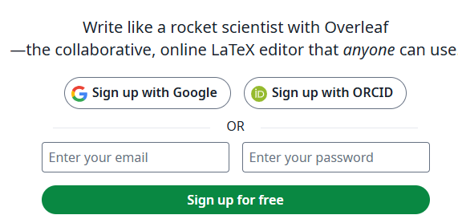
Overleaf
collaborative, online LaTeX editor that anyone can use
Notes:
Bring your laptops next week to do some exercises in class

Slide 15
Bibliography vs References
A "bibliography" lists all sources consulted during research, including those not directly cited in the text, while "references" only include sources that were explicitly cited within the paper, essentially documenting the specific sources used to support claims made in the writing; a bibliography is broader than a reference list.
Key points:
Bibliography: Includes all sources reviewed during research, even if not directly cited in the text.
References: Only includes sources that were directly cited within the paper.
Example: If you read several books to research a topic, your bibliography would list all of them, but your reference list would only include the books you specifically mentioned in your paper.

Slide 16
Citations
What is a citation and citation style?
A citation is a way of giving credit to individuals for their creative and intellectual works that you utilized to support your research.
It can also be used to locate particular sources and combat plagiarism. Typically, a citation can include the author's name, date, location of the publishing company, journal title, or DOI (Digital Object Identifer).
A citation style dictates the information necessary for a citation and how the information is ordered, as well as punctuation and other formatting.

Slide 17
Citations
How to do I choose a citation style?
There are many different ways of citing resources from your research. The citation style sometimes depends on the academic discipline involved. For example:
APA (American Psychological Association) is used by Education, Psychology, and Sciences
MLA (Modern Language Association) style is used by the Humanities
Chicago/Turabian style is generally used by Business, History, and the Fine Arts
https://pitt.libguides.com/citationhelp

Slide 18
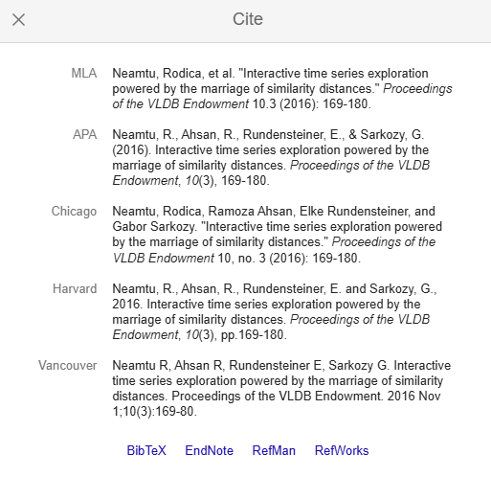

Slide 19
Citation Style to Use for Computer Science
The ACM citation style
The APA citation style
The IEEE citation style

Slide 20
Citation Style to Use for Computer Science
The ACM citation style
Format needed for a full citation in the reference list
In-text citations
[1] Simone Porru, Andrea Pinna, Michele Marchesi, and Roberto Tonelli. 2017. Blockchain-Oriented Software Engineering: Challenges and New Directions. In 2017 IEEE/ACM 39th International Conference on Software Engineering Companion (ICSE-C), IEEE.
In recent years, much debate has been stirred regarding the power of peer-to-peer systems [1].

Slide 21
Citation Style to Use for Computer Science
The APA citation style
Usually associated with the humanities, APA has now become a prominent citation style within the computer science field.
In-text citations
Wallace, A., Dietz, V., & Cairns, K. L. (2009). Integration of immunization services with other health interventions in the developing world: what works and why? Systematic literature review. Tropical Medicine & International Health, 14(1), 11–19.
Presence of a strong immunization service prior to integration is considered as one of the two characteristics of success (Wallace et al., 2009).

Slide 22
Citation Style to Use for Computer Science
The IEEE citation style
Mainly targeted at engineering, computer science, and information technology
In-text citations
[9] I. Bashir, Mastering Blockchain: Distributed ledger technology, decentralization, and smart contracts explained, 2nd Edition, 2nd ed. Birmingham, England: Packt Publishing, 2018.
Blockchain is an emerging technology holding significant promise [9].

Slide 23
Difference between ACM and IEEE citation style
while both use numerical in-text citations, ACM tends to prefer full author names in the reference list, whereas IEEE often uses initials
ACM
Focus on computer science:
Primarily used in publications related to computer science by the Association for Computing Machinery
IEEE
Engineering focus:
Primarily used by the Institute of Electrical and Electronics Engineers, often in engineering fields including computer science/engineering.

Slide 24
Citation Style to Use for Computer Science
The Chicago citation style
In the 17th edition, there were two distinct styles of referencing: notes and bibliography, and author-date. We'll be focussing on author-date here.
In-text citations
Chassignol, Maud, Aleksandr Khoroshavin, Alexandra Klimova, and Anna Bilyatdinova. 2018. “Artificial Intelligence Trends in Education: A Narrative Overview.” Procedia Computer Science 136: 16–24.
Artificial intelligence will soon be an internal part of our digital lives (Chassignol et al. 2018).
Notes:
https://pitt.libguides.com/citationhelp/chicago#:~:text=Chicago%20is%20a%20documentation%20syle,Bibliography:%20Weinstein%2C%20Joshua%20I.

Slide 25
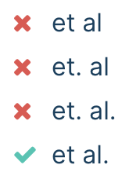
“et al.”
“et al.” is short for the Latin term “et alia,” meaning “and others.” It is used in academic citations when referring to a source with multiple authors:
Punctuation
Hulme et al. (2019) argue that …

Slide 26
“et al.”
“et al.” may be directly followed by other punctuation where necessary, but the period always comes first:
When “et al.” comes right at the end of a sentence, only one period is used:
(Smith et al., 2013)
This is a time-intensive process, as shown by Davies et al. [1]

Slide 27
“et al.” vs. “etc.”
“et al.” should not be confused with “etc.”; it is used for lists of people, whereas “etc.” is used for lists of things and concepts:
McDonnell et al. (2012) discuss various identity considerations (gendered, racial, etc.) that may bias the results.

Slide 28
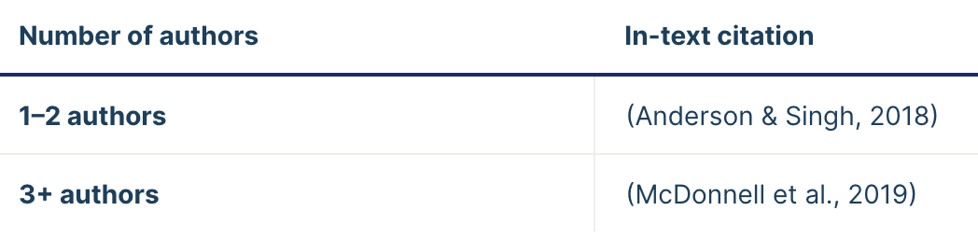
How to use “et al.”
Using et al. in APA Style
When a source has two authors, list both.
When there are three or more authors, cite the first author followed by “et al.”

Slide 29
Quotation and Paraphrase
Quotation reproduces a statement word-for-word as it appears in its original source
Paraphrase explains a statement by using your own words and sentence structure

Slide 30
Quotations
Direct quotations can be useful when the exact wording of a statement is important. The exact wording of a quotation may be significant to your claim.
Direct quotation may be important when you want to make sure you are being precise in representing the author’s position.
Finally, you might choose to use a direct quotation when the original statement is particularly well written or structurally persuasive

Slide 31
Paraphrasing
Paraphrasing is usually expected in research and argumentative essays.
These type of papers benefit from paraphrasing because it shows that you understand the source and are therefore a reliable voice on that source.
Paraphrasing can make the evidence more straightforward.
Another reason to paraphrase is to adjust your tone for your audience.
https://louisville.edu/writingcenter/for-students-1/common-writing-questions-1/what-is-the-difference-between-quotation-paraphrase-and-summary

Slide 32
Paraphrasing - Example
Original quotation:
“In the case of Facebook, it has changed its format multiple times, and merged other literacy practices – email, instant messaging, games – into its structure in an attempt to keep users on the site” (Keller 2014, 74).
Paraphrase:
Facebook has tried to hold on to its users by incorporating new functions like games and email (Keller 2014).
https://louisville.edu/writingcenter/for-students-1/common-writing-questions-1/what-is-the-difference-between-quotation-paraphrase-and-summary

Slide 33
Paragraph Structure
Sentence
A sentence in English is the basic unit of grammar and thought. However, the paragraph is the basic unit to organize that thinking.
without paragraphs, there is only grammar, not really writing.
A sentence can be perfectly correct grammatically but may not be the right sentence for that Generally,.
Paragraph
In research and professional writing, we don’t communicate in sentences, but in paragraphs.
Generally, have one clear main idea per paragraph in the form of a topic sentence

Slide 34
Paragraphs and flow
Paragraph
Topic sentence
Discussion of topic
Closing sentence
Thematic and grammatical links
Logical progression from one paragraph to the next
Demonstrate links in your language
Writing a literature review, Faculty of Medical Sciences, Dr Adam Potts

Slide 35
Components of a Paragraph (1/2)
Transition sentence (Optional)
The paragraph may open with a transition from a previous paragraph.
Transition sentences or clauses may also occur between the controlling ideas that elaborate the topic sentence in the paragraph.
Background information
Before the main point of the paragraph is given, there may be some background information on the topic that provides some context for the reader before the topic sentence is introduced.
Topic sentence (recommended)
The topic sentence gives the main point of the paragraph that must be explained, defined, proven, or analyzed
It is almost always at the beginning of the paragraph.

Slide 36
Components of a Paragraph (2/2)
Elaboration of the topic sentence (optional)
The topic sentence may be a very general statement. The elaboration sentence gives more specific details of the structure of the paragraph that follows.
Supporting sentences (required)
This is the standard type of sentence that develops the topic sentence.
All of the sentences in the paragraph should support the topic sentence.
If a new topic is introduced, a transition or a new paragraph should also be introduced.
Conclusion (optional)
A sentence that summarizes the key points of the paragraph

Slide 37
Exercise 1
Create a sample Article in overleaf
Create an account on overlead
Login
Create a new project
Set project name
Use the following steps to create a simple document
Notes:
https://www.overleaf.com/learn/latex/Learn_LaTeX_in_30_minutes

Slide 38
Writing first piece of Latex
\documentclass{article}
\begin{document}
First document. This is a simple example, with no
extra parameters or packages included.
\end{document}

Slide 39
The preamble of a document
Document content was entered after the \begin{document} command
Everything appearing before that point is preamble (document setup)
Within preamble you define document class (type) along with different specifics, loading packages you would like to use
Example preamble
\documentclass[12pt, letterpaper]{article}
\usepackage{graphicx}

Slide 40
Including title, author and date information
\title{My first LaTeX document}: the document title
\author{Ramoza Ahsan}: here you write the name of the author(s) and, optionally, the \thanks command within the curly braces:
\thanks{Funded by the Overleaf team.}: can be added after the name of the author, inside the braces of the author command. It will add a superscript and a footnote with the text inside the braces. Useful if you need to thank an institution in your article.
\date{March 2025}: you can enter the date manually or use the command \today to typeset the current date every time the document is compiled

Slide 41
\documentclass[12pt, letterpaper]{article}
\title{My first LaTeX document}
\author{Ramoza Ahsan\thanks{FAST NU}}
\date{March 2025}

Slide 42
To typeset the title, author and date use the \maketitle command within the body of the document
\begin{document}
\maketitle
We have now added a title, author and date to our first \LaTeX{} document!
\end{document}

Slide 43
Resulting preamble and body
\documentclass[12pt, letterpaper]{article}
\title{My first LaTeX document}
\author{Ramoza Ahsan\thanks{FAST NU}}
\date{August 2022}
\begin{document}
\maketitle
We have now added a title, author and date to our first \LaTeX{} document!
\end{document}

Slide 44
Basic document structure
Abstracts
\begin{abstract}
This is a simple paragraph at the beginning of the
document. A brief introduction about the main subject.
\end{abstract}

Slide 45
Paragraphs and new lines
how a new paragraph is created by pressing the "enter" key twice, ending the current line and inserting a subsequent blank line;
how to start a new line without starting a new paragraph by inserting a manual line break using the \\ command, which is a double backslash; alternatively, use the \newline command

Slide 46
If writing a Book chapter
\chapter{First Chapter}
For the research papers
\section{Introduction}
\subsection{Motivating Example}
\bibliography{Name of file}
\bibliographystyle{IEEEtran} or \bibliographystyle{abbrv}

Slide 47
Thank you
Questions?

